Slide 1
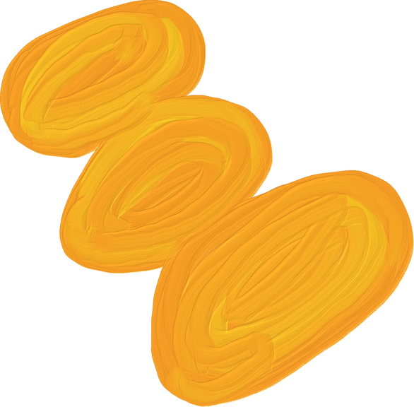
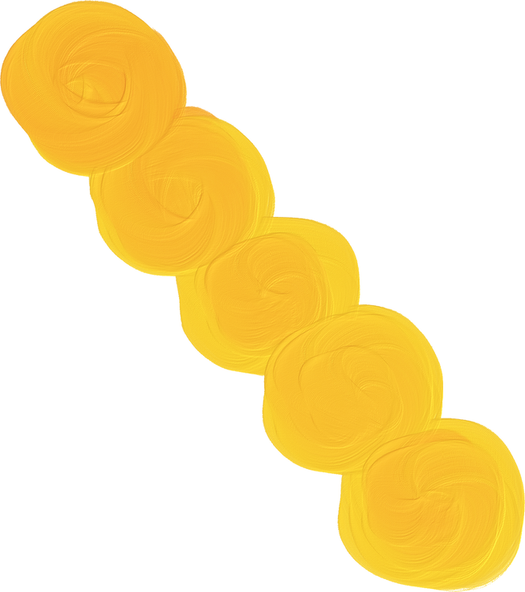

Unit Converter
Made By: Jerelene Serantes

Slide 2

Description
A unit converter is a tool or application that helps users change a quantity expressed in one unit of measurement into an equivalent value in another unit.

Slide 3

Input
Output
A numerical value
The original unit
The target unit
The equivalent value is the target unit.

Slide 4
Why it’s useful?
It quickly performs conversions that would otherwise require looking up formulas. Manual conversions can lead to mistakes. This Unit Converter is useful in converting measurements from different units. By using this you can avoid errors by calculating manually and also it's very easy and fast to use. You can quickly input the value and get accurate results, making it handy aid for both academic and everyday tasks.

Slide 5
Start
Flow Chart
Print welcome message
Input value
and units
Yes
Length conversion?
Convert Length
Yes
Weight conversion?
Convert Weight
Print Result
End
Yes
Convert Temperature
Temperature conversion?
No
Invalid Conversion Message

Slide 6


End
of Presentation

